Slide 1
Data Careers
How to become a competent data professional?
Adwait Bhave

Slide 2
About
Data Career = Data Analysis + [New] Data Mining + Data Science + Machine Learning +
Non ML Artificial intelligence + Data Visualization + Data Governance + DD Leadership
What skills are required for data career, and how to learn these?
How can you maximise your chances of employment?
What fundamental and timeless changes can be expected while learning and doing data?
Notes:
Ref :
Data scientist a useless job title : https://yanirseroussi.com/2016/08/04/is-data-scientist-a-useless-job-title/

Slide 3
Types of data careers
Data Careers are not clearly defined. What kind of data career is for you?
Analysers: Researcher, Applied Researcher, Scientist, Statistician, Modeller
Builders: Developer, Engineer, Manager
Traders: Business, Leader, Entrepreneur
Supporters: Recruiter, Trainer
Explainers: Journalist, Artist, Visualization Expert, Evangelist
Problem Solving
Statistics & Mathematics
Programming
Database
Communication
Business
Notes:
Ref:
Analyzing the Analyzers: http://www.stat.wvu.edu/~jharner/courses/dsci503/docs/Analyzing_the_Analyzers.pdf

Slide 4
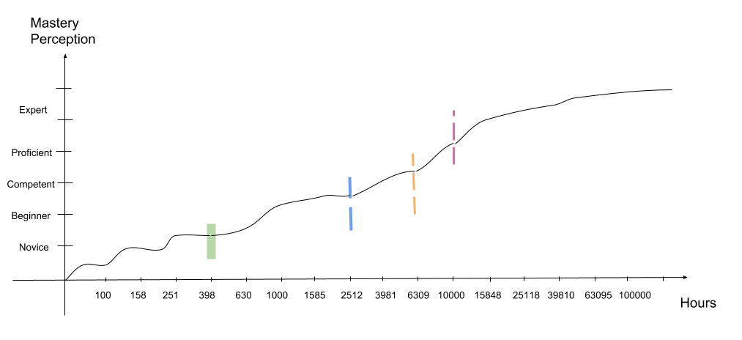
How a complex skill is acquired?
200 days 2 hrs/day 700 days 3 hrs/day 630 days 6 hrs/day 365 days 10 hrs/day
=~ 5-6 years

Slide 5


Before you start…
Initial Enthusiasm
Fatigue
Why? What are my weaknesses and fears? What can go wrong?
Notes:
Why I want to be in data career?
I am excited by the hype around it and I would like to check if it works for me.
I have 10 years plus experience solving software problems, but now I am doing more repetitive work. I think I should be solving more challenging problems.
The word ‘AI' fascinates me and it almost looks like out of sci-fi books.
What are my weaknesses and fears?
Are there any jobs in this field?
My current job is paying me well and it is much better strategy to focus and grow in the same job.
If I start now, I'll be again like a novice in the field and no-one will hire me with salary commensurate with my overall experience.
This field requires lot of statistics and mathematics. I am not good at any.
I am not a smart person. I understand things very slowly, almost painfully.
What can go wrong?
Data career sounds all good, but this will too pass just like Cloud / Java / . What is the point in jumping on to it. I better act as a wise person who has seen these cycles come and go.
This is going to be one of those things where I am excited about it and then it wanes off. And again losing interest in one more thing will confirm that I do not have what it takes to reach my desired destination.
This could be more like a buzzword and my all efforts will go waste when the trend changes.
Enthusiasm & Confusion
Overwhelmed. job getting compromised. Less family time. and zero knowledge of anything.

Slide 6
398 Hrs rule
Confirming your interest. Not quitting before you spend 398 hrs.
One article / tutorial for a week. Spend less than 10 hrs/week.
Avoid talking about your interest.
Spend some time everyday.
Use your existing skills.
Create personalized problem statement.
Notes:
Ref :
Symbolic Self-Completion, Attempted Influence, and Self-Deprecation: https://www.socmot.uni-konstanz.de/sites/default/files/81_Wicklund_Gollwitzer_Symbolic_Self-Completion_Attempte.pdf

Slide 7
Questions at beginner
How do I know that the tutorial I am following is ‘the best’?
How to cover for prerequisites in maths and stats?
How I can use my knowledge in my current job?
How to learn programming languages required for data career?
How do I get real world data?
How do I get practice problems?
Notes:
Feeling at beginner stage : I wish I have someone who can assure me of the best path to follow. If I just keep doing it ad-hoc then I may waste my efforts.

Slide 8
Courses and Mentors
MOOC or Classroom?
Take one quality course at a time. Complete it, take a break and go over the material again.
Using the knowledge/code you have in the course, solve a problem at your job or life.
Start spending more time per week [> 10 hrs/week].
Choose the course having hands on implementation.
Start searching for a mentor. Ask him/her the interesting problems. Offer your help for free.
Notes:
Ref:
How to get most out of MOOC?
How to select best MOOC?
How to find mentors?

Slide 9
To Do for beginners
Focus on building something. Even it is a trivial problem.
First stage you were merely copying, now change something small, get pleasure of discovering new things not in the article/book/course.
Language does not matter at this stage. Octave, Julia, R, Python, Java anything welcome.
Follow 'simple done deep' . Take a simple concept, study it well. Study prerequisites. Apply to many datasets.
Push on GitHub / Show it to your friends. Don't be shy to say 'You don't know', but go back, learn it again and explain.
Notes:
You can talk to anyone about your interest!
This is a long phase. Keep consistent pace of efforts.

Slide 10
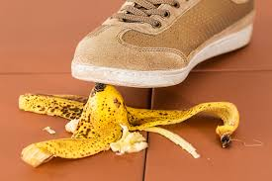
Warning!
Good MOOCs can give you over confidence.
Courses and Mentors are not enough for job and interviews.
Data career is more than technical know-how and hacking.
Do not accept ‘everyone is learning’ jobs. Better to build profile first!
Your experience can work against you.

Slide 11



Adding competition and complexity.
Kaggle is the best way to learn practical stuff. You learn many street smart kind of tricks for data.
You develop lot of interesting code pieces which come handy in your job too.
If you come in top 1% of Kaggle board, You may get calls from the recruiters.
Kaggle is a huge time commitment, but it is worth to do it.
Weekend hands on courses
Workshops & Bootcamps
Take a break. Do a course.
Masters or PhD

Slide 12
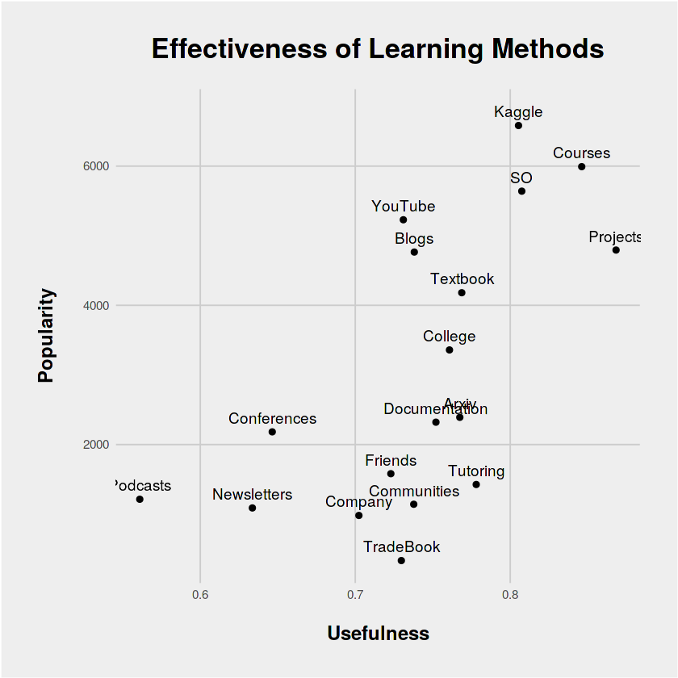
Most effective way to learn
Notes:
Ref :
https://www.kaggle.com/jackcook/how-to-become-a-data-scientist/notebook

Slide 13
Tips for progression
Focus on one language.
Implement out of library techniques.
Learn to communicate results of your work. (blog posts /infographics/ Q&A)
Work in diverse domains.
Locate areas in your job where your skill can be applied.
Keep resume active and give interviews, gather questions.
Start marketing with local start-ups and offer to work for free on weekends.

Slide 14
Being competent
You no longer worry if you have made the right choice.
You actually live double life.
You start coming in top 10% in some of Kaggle competition.
You have collection of blog posts/code fragments and visualizations.
You have your own ideas and implement those using language of your choice.
In your job, people start calling you data guy and data works start coming to you.
Notes:
Double life : Your day job and then your adventures with data. You don't mind spending your nights tweaking algorithms.

Slide 15

What hiring managers look for
Great education
Great computer science background
High specialization
Talent Stack
Portfolio (Kaggle/ Open source/ Projects)
Great communication and soft skills
Attitude
Experience with Data

Slide 16
What surveys are telling?
Bangalore
Mumbai
Delhi
Financial
e-commerce
healthcare
40% bachelor
20% masters
2 to 5 years is a sweet spot (25% of the jobs)
Captives (56%)
IT service (18%)
Python
R
SQL
Lets look at some charts!
Notes:
Ref: Analytics and Data science study 2017
https://365datascience.com/research-into-1001-data-scientist-profiles/

Slide 17
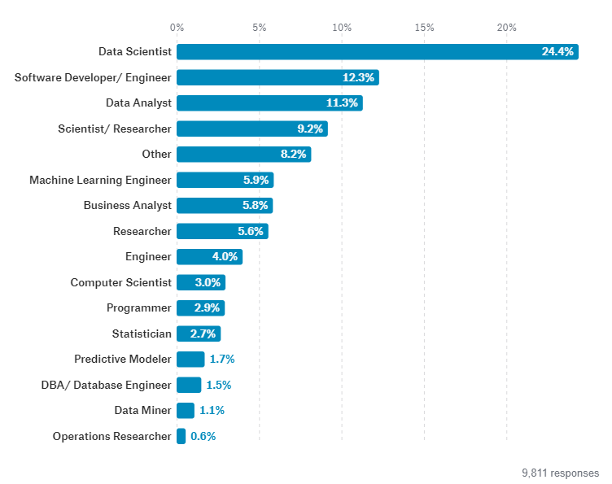
Designations & skills
Python 58%
SQL 54%
R 44%
Algorithms 38%
Java 32%
Big Data 28%
optimization 23%
C++ 21%
Distributed 20%
visualization 20%
Business Intelligence 18%
Unstructured 16%
Packages 15%
Notes:
Ref:
https://www.kaggle.com/surveys/2017

Slide 18
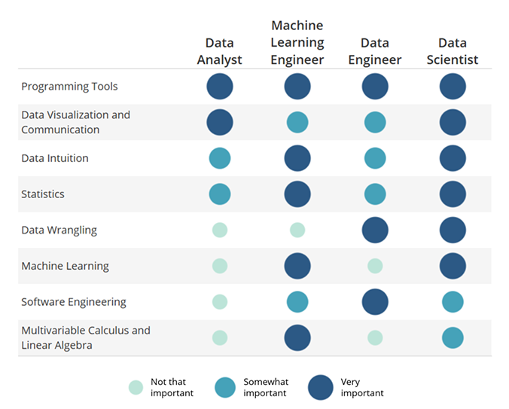
How much math?
Notes:
Ref:
https://www.kaggle.com/surveys/2017
CBSE syllabus : https://www.cbsesyllabus.in/class-12/mathematics-class-12-syllabus

Slide 19
What to learn in maths
How much do you know?
Sets
Functions
Matrices
Continuity and Differentiability
Applications of Derivatives
Vectors and three dimensional Geometry
Linear Programming
Counting and Probability
hypothesis testing
Distributions
Bayes rule
Apriori Algorithm
Linear Regression
Logistic Regression
Decision Trees
Naïve Bayes
K- Neighbour
Support Vector Machine
Ensemble
Dimensionality Reduction
Expectation Maximization
Data structure & Algorithm Analysis
Graph Theory

Slide 20
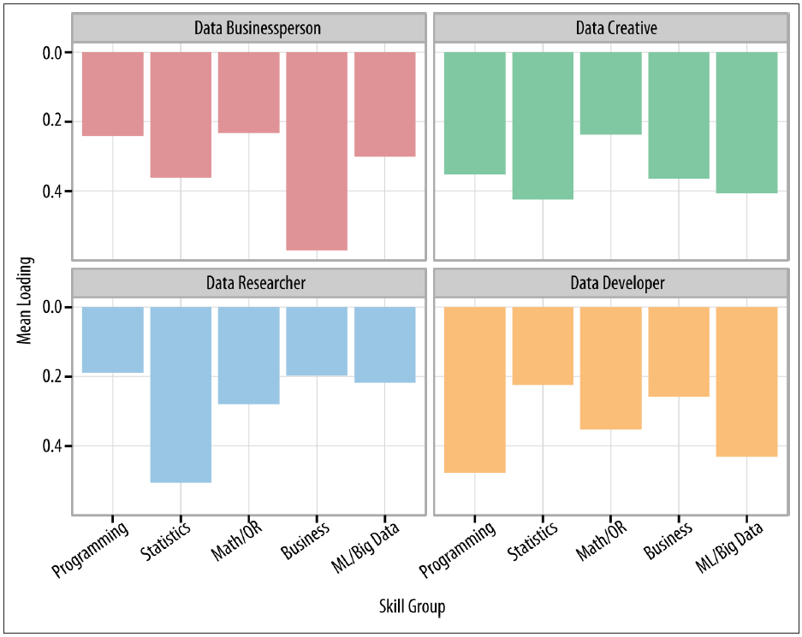
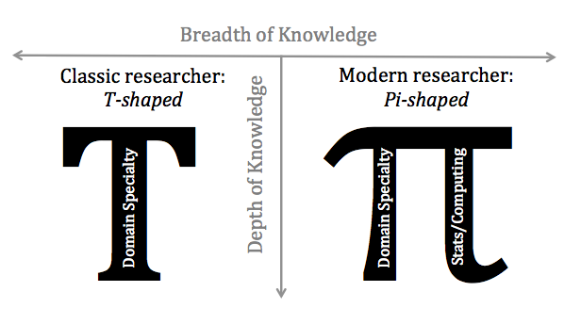
Other Skills…

Slide 21
General Profile
Bachelor in quant domain.
5 to 7 years overall experience with 2 to 3 years data experience.
Knowledge of R/Python and SQL.
Top University and good grades or 2-tier University and portfolio.
Proficiency in Java/C++.
NoSQL skills. Cloud scale computing experience.
Above Average communication skills (Story and Visualizations)
Notes:
Ref :
Can I Become a Data Scientist : https://365datascience.com/research-into-1001-data-scientist-profiles/

Slide 22
Strategy
Mindset
Money
Networking
Interviewing
Do not treat your current field and data career as separate fields.
Freelancing on Weekends.
Think how you can solve data problems in your field.
Learn continuously.
Weekend Entrepreneurship
Start up or Big
Flexibility
Realistic expectations
LinkedIn
Mentoring
Meetups
Recruiters
Courses
Answering interview questions is a skill.
Try to master it independently.
Selecting right opportunity to your goal.
Portfolio preparation

Slide 23
Above Competent
Identify your weaknesses. Augment those with fast pace courses and action plan.
Market yourself as a brand. Teach and present meaningfully.
Grab opportunity to mentor others, solve their problems for free.
Create your own data stores. Create your own code stores.
Never be afraid to bring in new ideas to solve your problems.
Diversify learning into unventured domains.

Slide 24
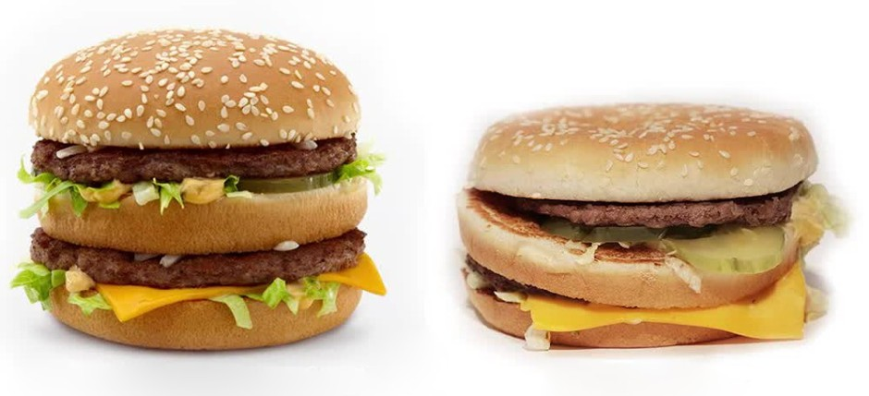
What if…
Not doing data is like not using computer.
You learnt/upgraded some very fundamental skills
Problem solving with data
Making Inference under uncertainty
Scientific and iterative approach to solve problems
Not suppressing curiosity and building your hunch
Communicating your findings to larger audience
How to learn extremely complex skill consciously ☺

Slide 25
Remember
Data careers are still in basic stage. Clear job roles yet to be defined. Choose data role based on your background and strengths.
Making sense of data is an art and science.
Beware of expert predictions. Do common sense things.
“If we follow the mastery process long enough, inspired by a profound interest and curiosity we cannot fail to achieve something exceptional.” — Robert Greene

Slide 26
Thanks
Adwait Bhave
LinkedIn: https://www.linkedin.com/in/adwaitbhave/

Slide 27
Images
Images with are copied only for analysis. And contains attribution at bottom.
All other images(with no attribution) are taken are copyright free images (no attribution required)
Sources :
https://www.pexels.com
https://pixabay.com

Slide 28
References
Data scientist a useless job title : https://yanirseroussi.com/2016/08/04/is-data-scientist-a-useless-job-title/
Analyzing the Analyzers: http://www.stat.wvu.edu/~jharner/courses/dsci503/docs/Analyzing_the_Analyzers.pdf
Symbolic Self-Completion, Attempted Influence, and Self-Deprecation: https://www.socmot.uni-konstanz.de/sites/default/files/81_Wicklund_Gollwitzer_Symbolic_Self-Completion_Attempte.pdf
Analytics and Data science study 2017 https://365datascience.com/research-into-1001-data-scientist-profiles/
https://www.kaggle.com/surveys/2017
CBSE syllabus : https://www.cbsesyllabus.in/class-12/mathematics-class-12-syllabus

Slide 29
References
Role of deliberate practice : http://projects.ict.usc.edu/itw/gel/EricssonDeliberatePracticePR93.PDF
Mastery by Robert Greene

